Slide 1
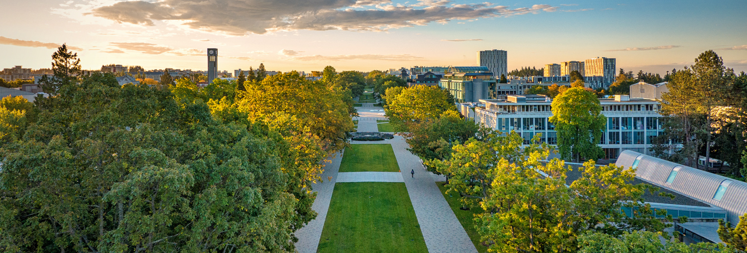
Navigating the implicit rules of the post-covid job market
David J. Hardisty
ESSEC University Seminar, March 9 2023

Slide 2
The “hidden curriculum” in doctoral education
Some of the most critical knowledge for academic success is not taught in classes (e.g., how to select a research program & co-authors, how to apply for grants, how to apply for jobs, etc.; Elliot et al, 2020).
The academic Marketing job market has many unwritten rules
My previous attempts to make the “rules” explicit have been rendered somewhat obsolete:
  “AMA Transitions Guide: Navigating the Progression from Doctoral Student to Marketing Professor” (2015) https://www.ama.org/ama-transitions-guide-navigating-the-progression-from-doctoral-student-to-marketing-professor/
  “2019 guide to the American Marketing Association (AMA) job market interviews for aspiring professors” http://www.decisionsciencenews.com/?p=6959
New, post-COVID norms are developing! But always a chaotic process. A bit like dating.

Slide 3
Disclaimers
I’m going to make some broad generalities here! (Of course, there are many differences between people, universities, regions, time periods, etc.)
Today, I’m aiming for “real talk” efficiency and transparency over nuance.
This is only my perspective.
My experience is more with CB and more with North America.
Non-academic job-market search is totally legit, but is completely different and is outside the scope of this talk.

Slide 4
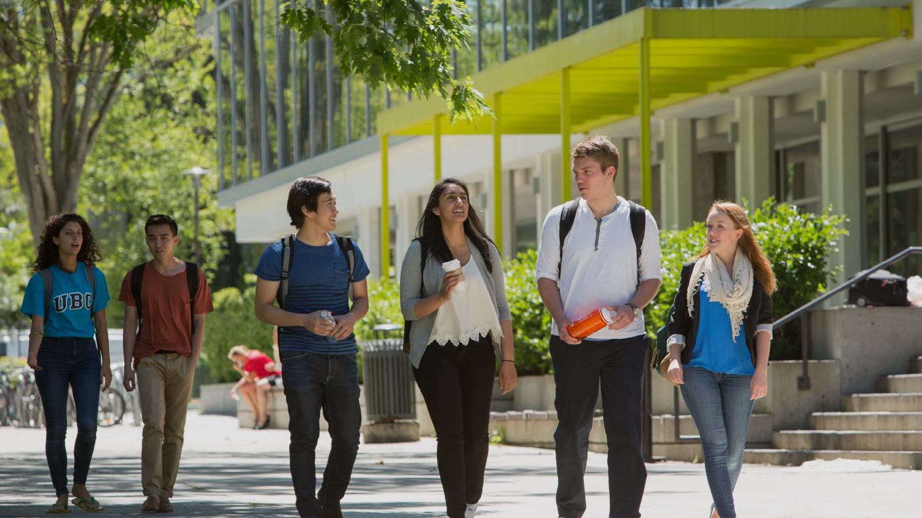
Building Your Profile

Slide 5
Building Your Profile
Peer-reviewed publishing success (at minimum, an R&R at a decent journal). First author. Declining marginal utility for additional publications. Some schools only value pubs in FT50 journals, others value interdisciplinary journals as well. Recommendation: As a student: put your strongest effort on your project that is closest to publication.
Distinct research area (topic and/or methodology). Helps if it’s trendy (e.g., AI marketing, DEI, etc.). Your goal is to be the world expert on something. Needs to be something you actually care about.
Helps to have supporting projects in other, related areas, to connect with faculty & fill departmental needs
Teaching counts a little bit too, but this is mostly judged off the strength of your research presentation.
Being an active participant in research seminars and conferences can help. Being collegial usually helps.
Coursework and grades are largely irrelevant (other than what you learn in the courses).

Slide 6
Application Timing

Slide 7
Application Timing
Jobs are posted on ELMAR and jdm-society throughout the year (subscribe!), up to a year or more before the start of the job
Anonymous Excel tracking sheet (not always accurate!): https://docs.google.com/spreadsheets/d/14QC-5jJ651nSW0OY0kb_YxnTZyugxNyz_8wa2KDmKs0/edit?usp=sharing
Earliest you should go on the market would be the summer after your 4th year. However, the job market does not adjust sufficiently for years of preparation, so if you take extra time (in PhD or Post-doc), you will have an advantage
Some schools (especially Asian?) have early summer application deadlines and have exploding offers by September
Many schools have application deadlines at the end of the summer (August), do 1st-round interviews on Zoom Sept-Oct, and flyouts Oct-Nov
“Secondary market” happens throughout the spring, until as late as June (for jobs starting the next month!)

Slide 8
Application Package

Slide 9
Application Package
CV, research statement, copies of papers, teaching statement, teaching materials/reviews, reference letters, diversity statement. Get several recent successful examples to use as templates – people are happy to share.
Typically you have one “job market paper” to represent your research. But, you can combine two papers. Some schools require unpublished work, others want your best work. When in doubt, ask!
Tailor your research statement to each school if possible (not mandatory).
Only apply to schools where you actually want to go.
Credible matching signals (such as geographic constraints or research fit) can help a bit.

Slide 10
First Round Interviews

Slide 11
First Round Interviews
It’s a very random process and the “mode” is rejection, so don’t take it personally when you don’t get an interview (if you have a contact, it’s ok to ask why)
Typically 20-30 minutes, on Zoom. You present one project (perhaps 2-3 studies), give an overview of your other research, answer questions, ask questions
Get recent, successful examples to use as templates
Practice! Practice! Practice! Tell your practice audiences to be jerks and interrupt you all the time with tough questions
Be sure you understand the question fully before you answer it
DO NOT read from a script (even though it’s tempting on Zoom!)
“Do your homework” before the interview – you should know who you are talking to, know the school, have questions ready
Kind of stressful, but also kind of great – this is the most attention and feedback you will ever get on your research

Slide 12
Flyouts

Slide 13
Flyouts
Typically the top 3-5 candidates are invited for a campus visit. The school will pay for your travel & hotel.
Typically a longer (1hr-1.5hr) research talk, plus meals and 1-on-1 meetings.
Advice is similar to first-round interviews: practice, do your homework
Show enthusiasm for the school but don’t be desperate (again, like dating!). Matching is more important at this stage – try to find connections with all the faculty you talk to.
They are not only looking for the best candidate, but also for a colleague and friend.
Odds are still low; when you don’t get the job, don’t take it personally. Remember, they are big fans of your work!
If you get an exploding offer, sometimes you can extend, but don’t let it expire unless you have another offer in hand. You can “trade up” later if you want.

Slide 14

Summary & Conclusions
The candidates are competing for schools, but the schools are also competing for candidates
If things don’t work out one year, you can always try again
Take care of yourself!

Slide 15
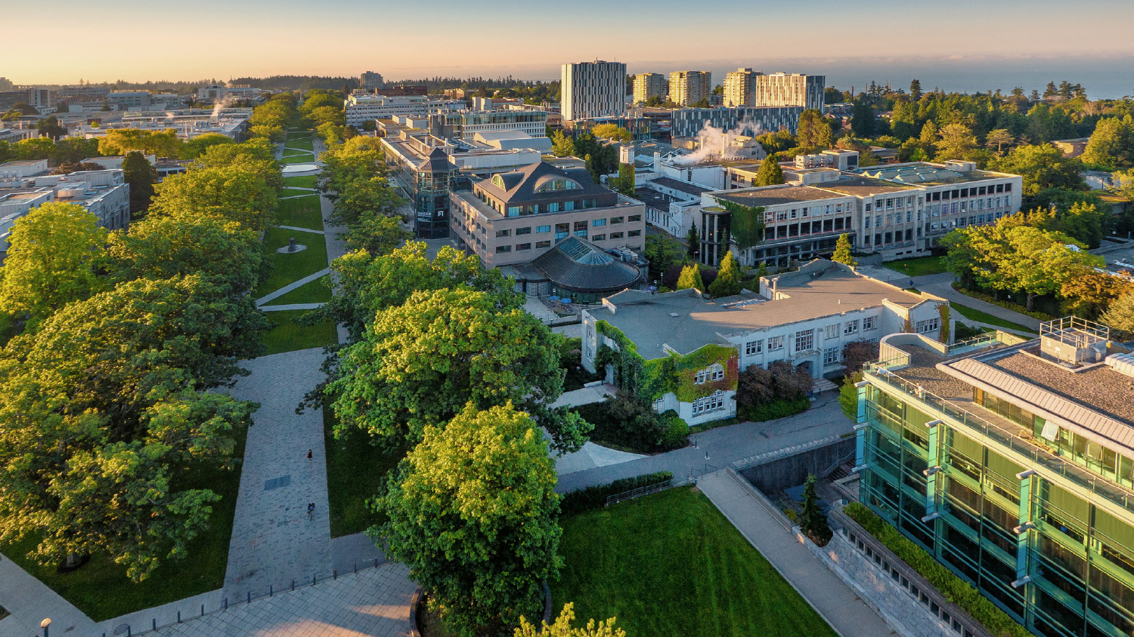
Thank you!

